Slide 1
Wrapper Classes

Slide 2
Objective
To involve primitives in activities reserved for objects (Collections)
To provide utilities functions for primitives, such as values parsing and casting

Slide 3
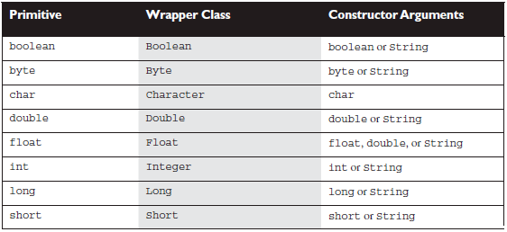
Wrapped Classes
For every primitive exists appropriate Wrapped Class in package java.lang.

Slide 4
Creating Wrapped Classes
There are several ways to create wrapper:
Integer i1 = new Integer(3);
Integer i2 = new Integer(“3”);
Integer i3 = 3;
Integer i4 = Integer.valueOf(“3”);
Wrappers are Immutable!

Slide 5
Remember: Wrappers are Objects
Integer i1 = new Integer(3);
Integer i2 = new Integer(“3”);
Integer i3 = 3;
Integer i4 = Integer.valueOf(“3”);
Integer i5 = Integer.valueOf(3);
i1 == i2
i2 == i3
i3 == i4
i4 == i5
false
false
true
true
use
equals()
!!!
???

Slide 6
valueOf
public static Integer valueOf(int i) {
if (i >= -128 && i <= IntegerCache.high)
return IntegerCache.cache[i + 128];
else
return new Integer(i);
}
Integer i3 = 3; → Integer.valueOf(3);

Slide 7
Utilities methods
Wrappers contain set of utility methods to deal with primitives:
xxxValue()
Float f = new Float(3.14f)
short s = f.shortValue();
parseXxx()
double d = Double.parseDouble(“5.6”)
valueOf()
toString()
toXxxString() (binary, hexadecimal, octal)
…
and more

Slide 8
Autoboxing
Since java 5: java converts primitives to/from theirs wrappers behind the scene.
Integer i = 5; // i = Integer.valueOf(5)
i ++; // i = Integer.valueOf(i.intValue() + 1)

Slide 9
Autoboxing: bad usage
Integer sum = 0;
for (int i = 0; i<10; i++) {
sum =+ i;
}

Slide 10
?

